Slide 1
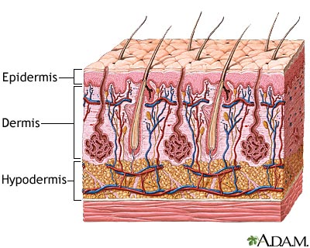
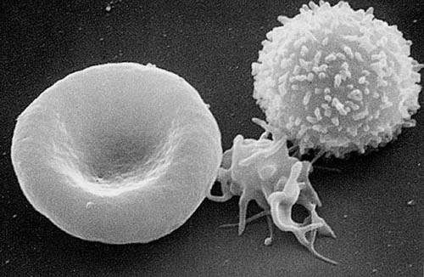
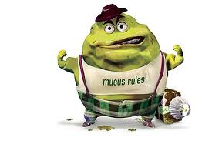
Infectious Diseases
Lesson 3.3

Slide 2
Lesson Objectives:
After finishing today’s lesson, you will be able to:
give two examples of virulence factors pathogens use to avoid the host’s immune barriers.
describe the symptoms of two infectious diseases you have not studied before today.

Slide 3
Do Now
List the host barriers of the:
non-sterile parts of the body
sterile parts of the body

Slide 4
Do Now
Describe briefly how each one of the barriers work.
Skin/Hair
Defensins
Intestinal epithelial cells
Mucus
Tears
Stomach acid
Human microbiota
Complement
Phagocytes
B cells and antibodies
T cells

Slide 5
Activity:
WAR CARD GAME
What’s in the cards?

Slide 6
Wrap Up
Which virulence factor impresses you the most?
What disease has symptoms that impress you the most?

Slide 7
Homework
Complete the answers to the questions on the card game worksheet.

